Slide 1


Introduction to LAMP and
Drupal
Raghuram.N
Free Software Movement Karnataka
www.fsmk.org
fsmk-discuss@lists.fsmk.in

Slide 2
Introduction to LAMP and
Drupal
What is Client Side Script?
Web program executes in Client Side(Browser)
Embedded within HTML/XHTML.
Scripts are sent to browser by the Web Server
It may contain instructions for the browser to follow in response to user actions
Eg:- javascript, jquery

Slide 3
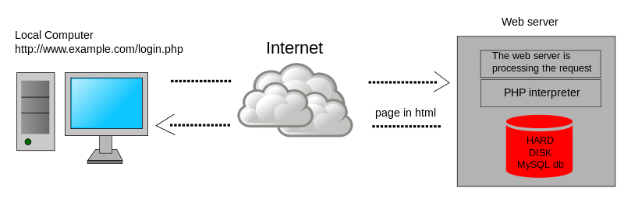
Introduction to LAMP and
Drupal
What is Server Side Script?
Executed by Web Server when the users requests a document.
Written in languages such as PHP, Perl, Java.
It produce the output in HTML format and then sent to the user's computer.
The user don't have access to the source code.

Slide 4
Introduction to LAMP and
Drupal
What is LAMP-SERVER?
LAMP – Linux, Apache HTTP Server, MySQL, PHP/Python
Its principal component to build a web page.
Apache – Developed and maintained by community(Apache Software Foundation).
Apache was chosen out of respect to the Native American tribe Apache and its superior skills in warfare and strategy.

Slide 5
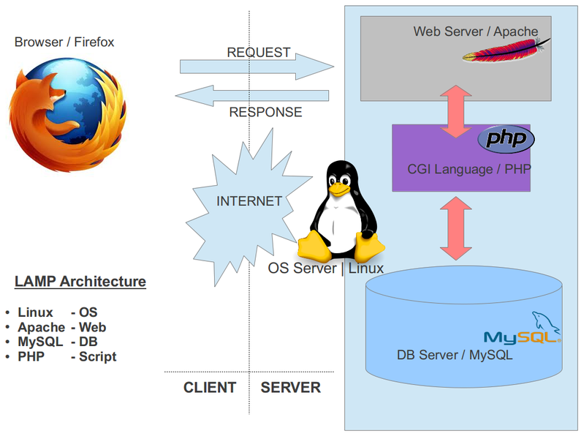
Introduction to LAMP and
Drupal
What is LAMP-SERVER?

Slide 6
Introduction to LAMP and
Drupal
Install LAMP
sudo apt-get install tasksel
sudo tasksel
sudo tasksel install lamp-server
Start/Restart LAMP Server
sudo /etc/init.d/apache2 restart
or
sudo service apache2 restart
Stop LAMP Server
sudo /etc/init.d/apache2 stop

Slide 7
Introduction to LAMP and
Drupal
What is CMS?
Content Management System
It allows publishing, editing and modifying content as well as maintenance from a central interface
Its designed to simplify the complex task
Often used as blog software
Allows user to control and manage the Web content without technical training.

Slide 8
Introduction to LAMP and
Drupal
Introduction to Drupal
Famous free software CMS
Developed and maintained by community
Distributed under GNU General Public License
It used to develop web sites for photo galleries, video galleries, forums, community, e-learning, informational websites, social networking, internal communication and marketing

Slide 9
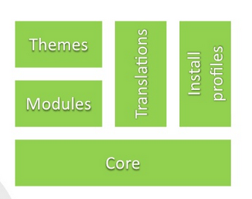
Introduction to LAMP and
Drupal
Drupal Architecture

Slide 10
Introduction to LAMP and
Drupal
Join Us to Spread Free Software
www.fsmk.org
fsmk-discuss@lists.fsmk.in
https://www.facebook.com/groups/151309701578334/

